Slide 1
Create Voice Project
Using Elevenlabs.io to create voice over for eLearning

Slide 2
Process Info
Owner name
Team
Resources
Tools
Description
 | AU Member | AU Member | AU Member | AU Member | AU Member | AU Member | AU Member | AU Member | AU Member
Date

Slide 3
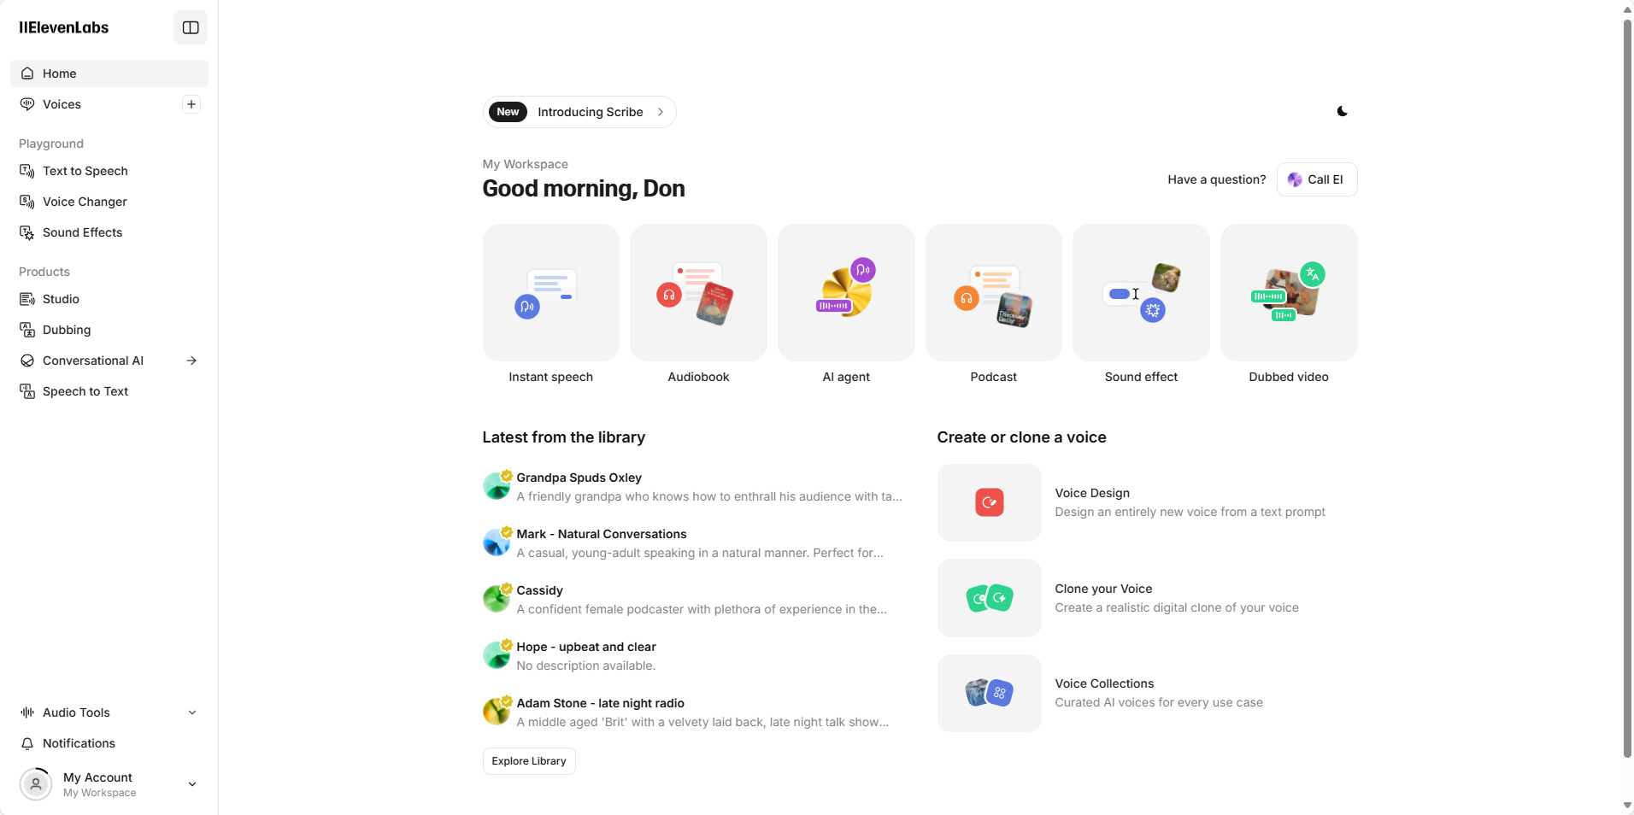
Create a new Elevenlabs Studio Project
1
Open Studio

Slide 4
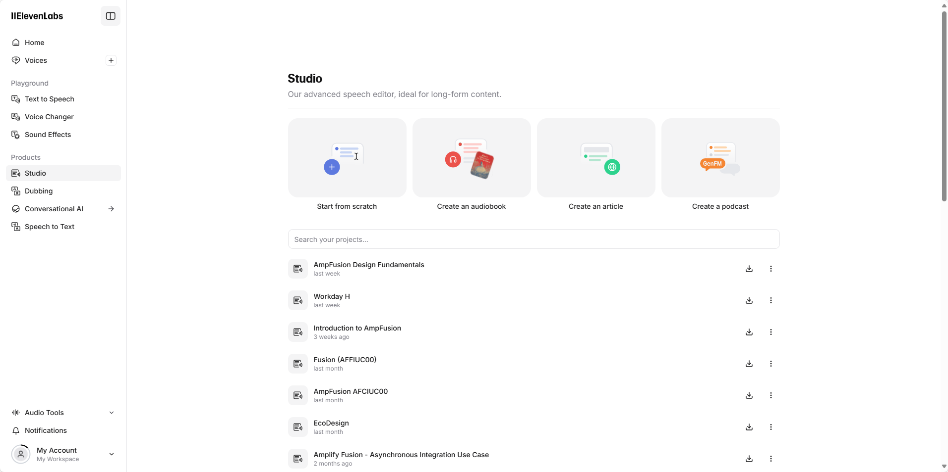
Create a new project
2
Click Start from Scratch

Slide 5
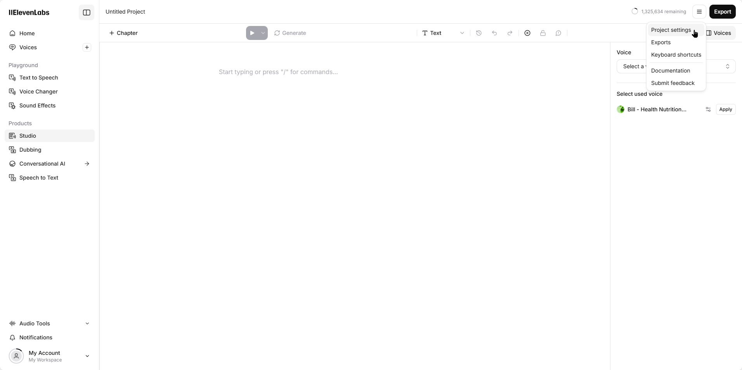
Create a new project
3
Click the menu in the top
right, click Project Settings

Slide 6
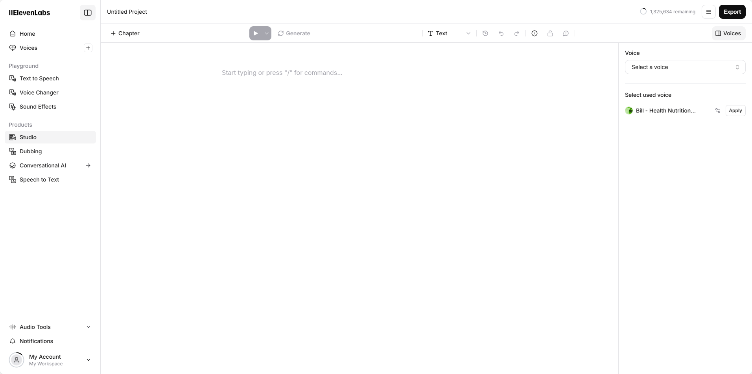
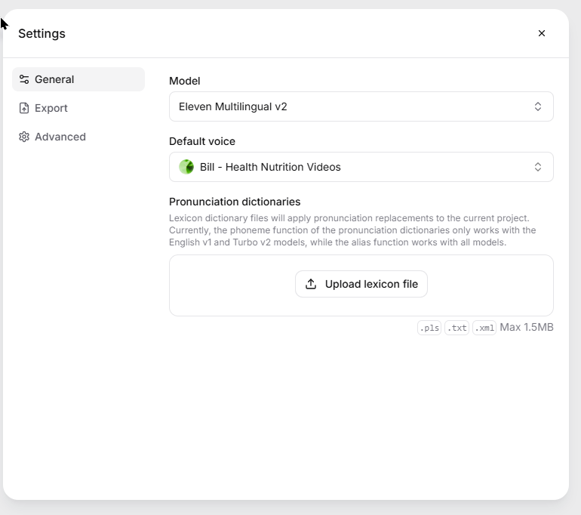
Create a new project
4
Select your voice here. You can do it later, but to avoid confusion, it’s best to do it at the beginning

Slide 7
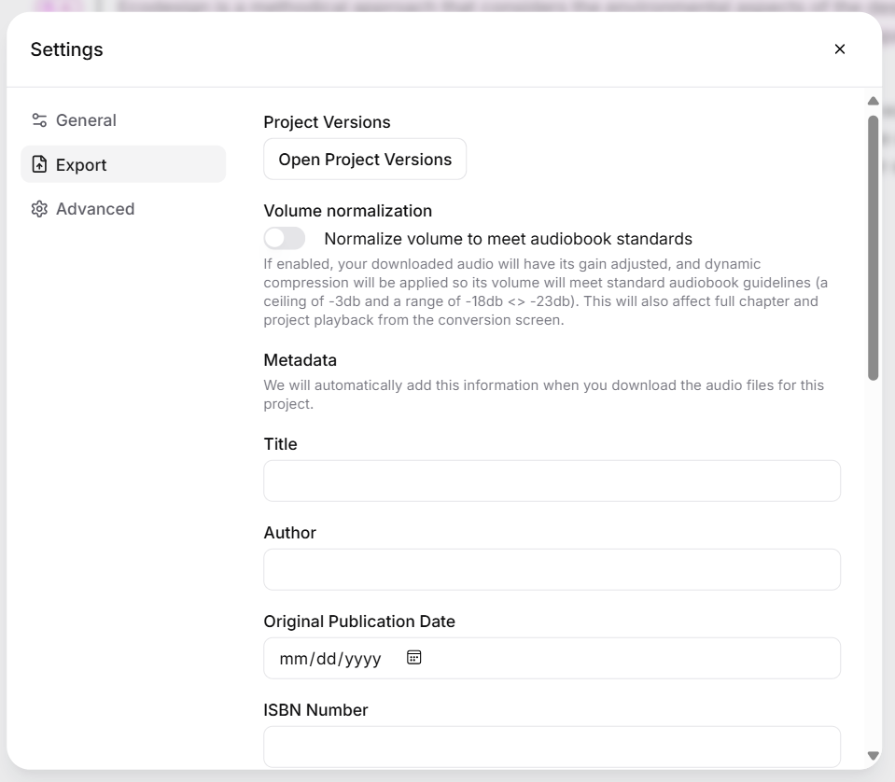
Create a new project
Do not select normalize volume here. This will degrade audio quality in the completed video. There are no other settings on this panel that we are using as of 03/07/25.

Slide 8
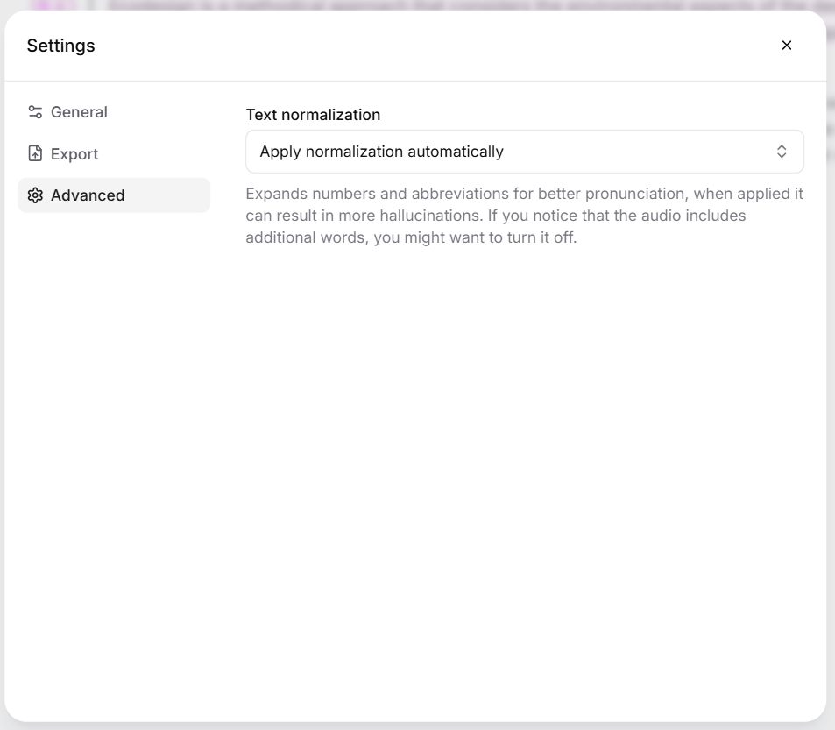
Create a new project
No changes necessary here. Leave this for best results.
Click the X when done.

Slide 9
Create Audio Files in Studio

Slide 10
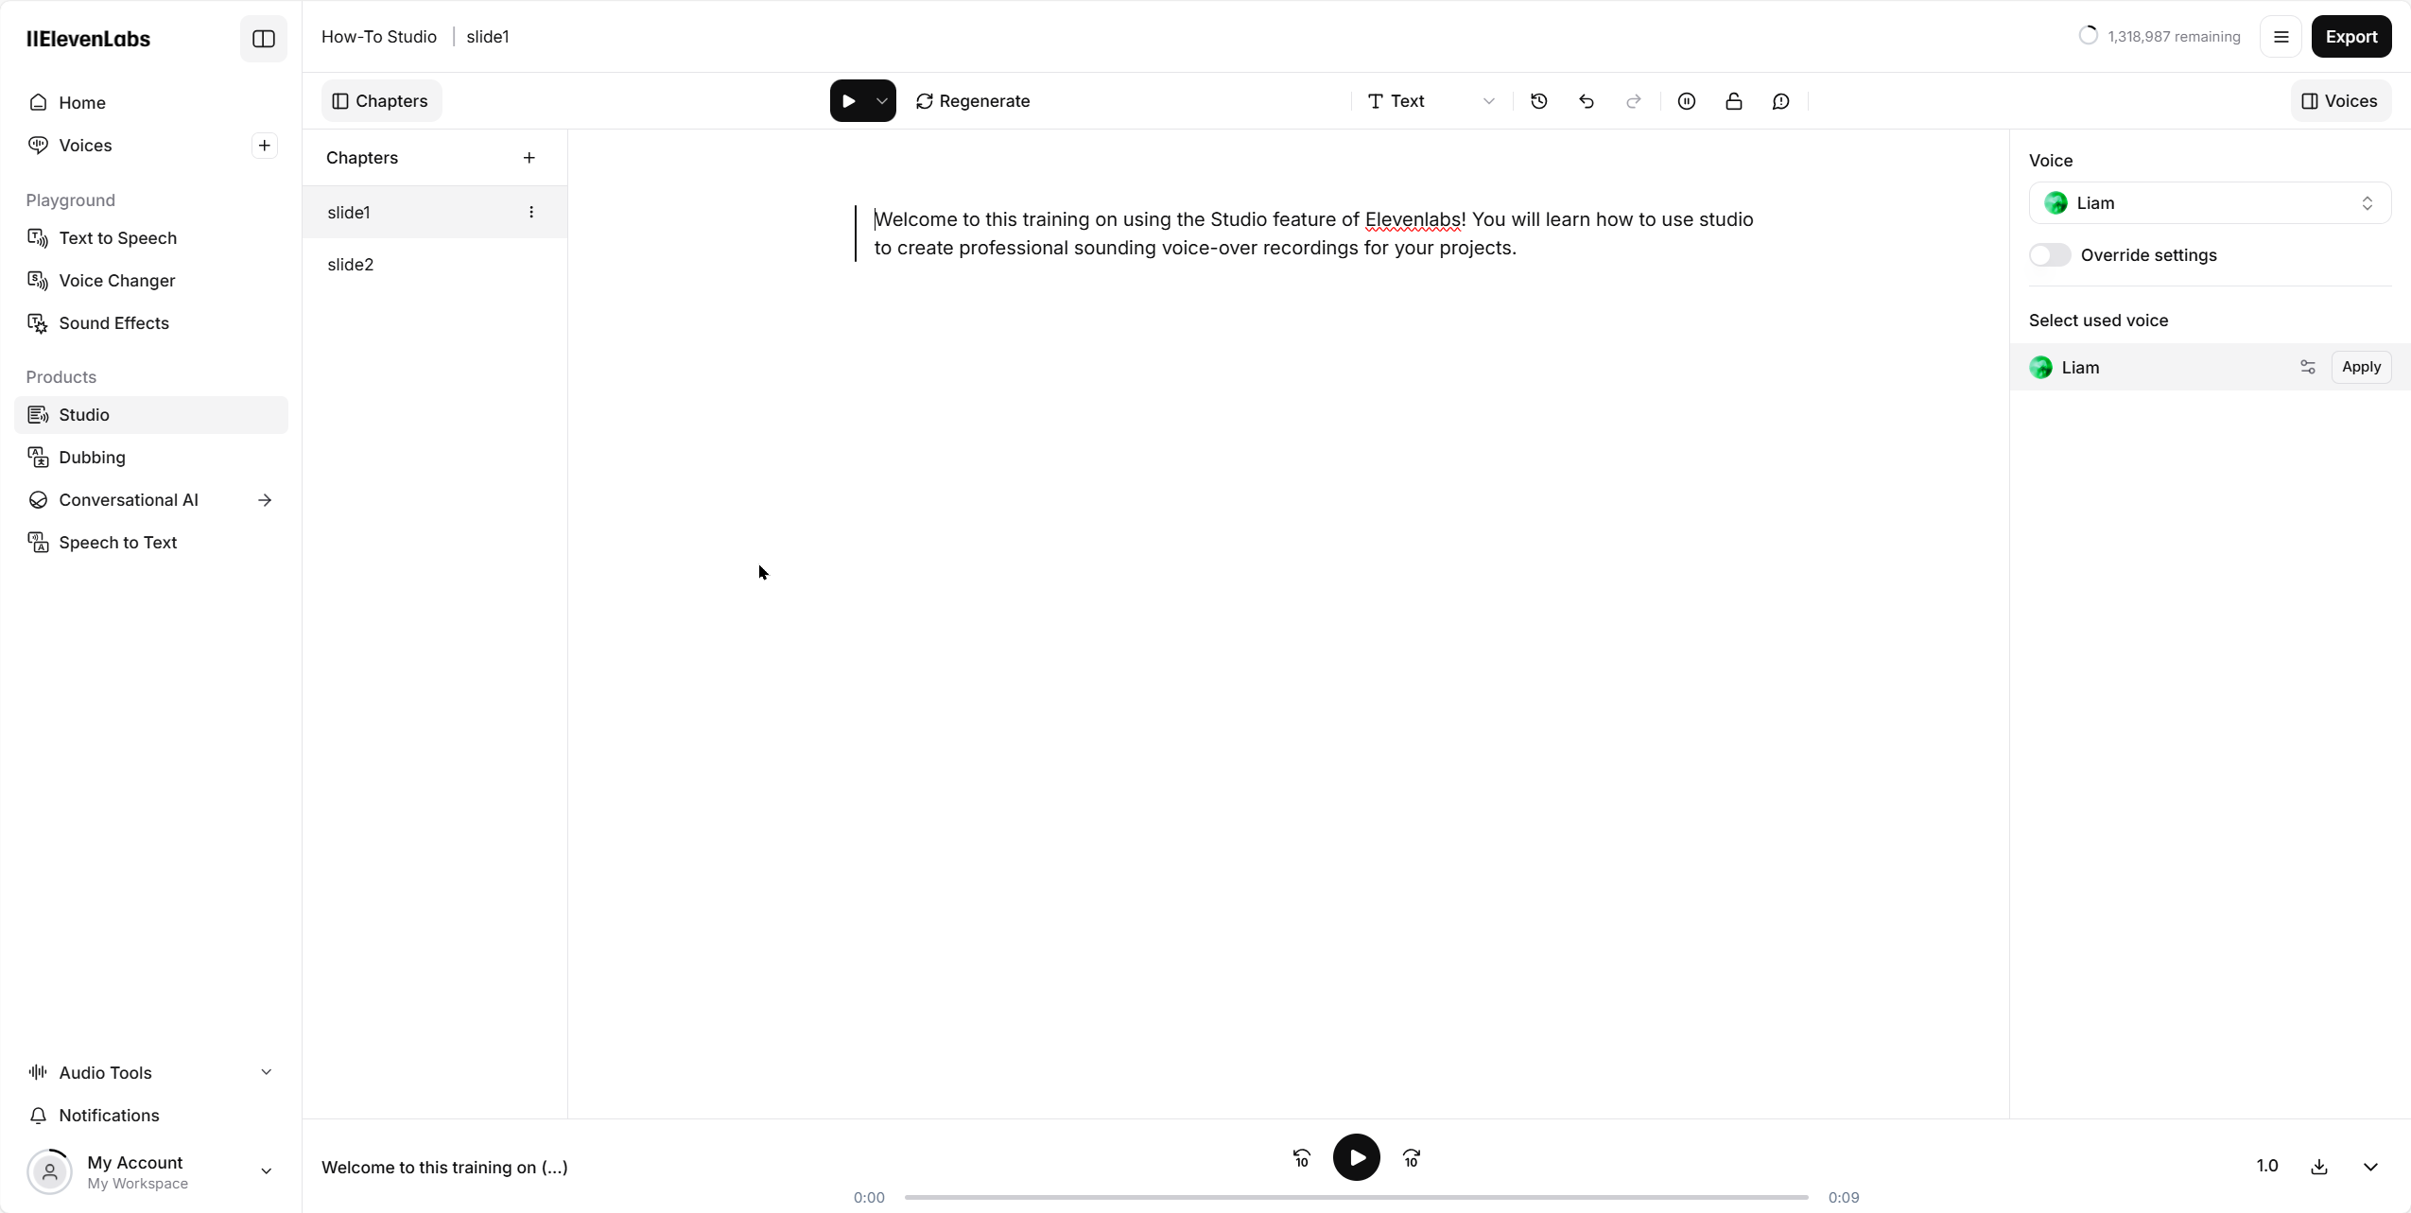
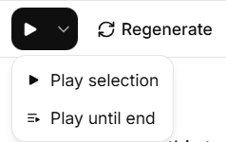
Create Voice Over Tracks
1
2
Create a new chapter. NOTE: The default name is Chapter XX where XX is the chapter number. You need to rename this to slidexx (no space). There is no way to set this up in settings, it must be changed one by one. It’s best to do it when you create the chapter.
Enter your text. You can copy/paste or type. NOTE, copy/paste from Office documents might give you artifacts. If it does, copy/paste to notepad first.
Repeat these steps to create more audio. There is no “save” button.

Slide 11
Export Audio Files from Studio

Slide 12
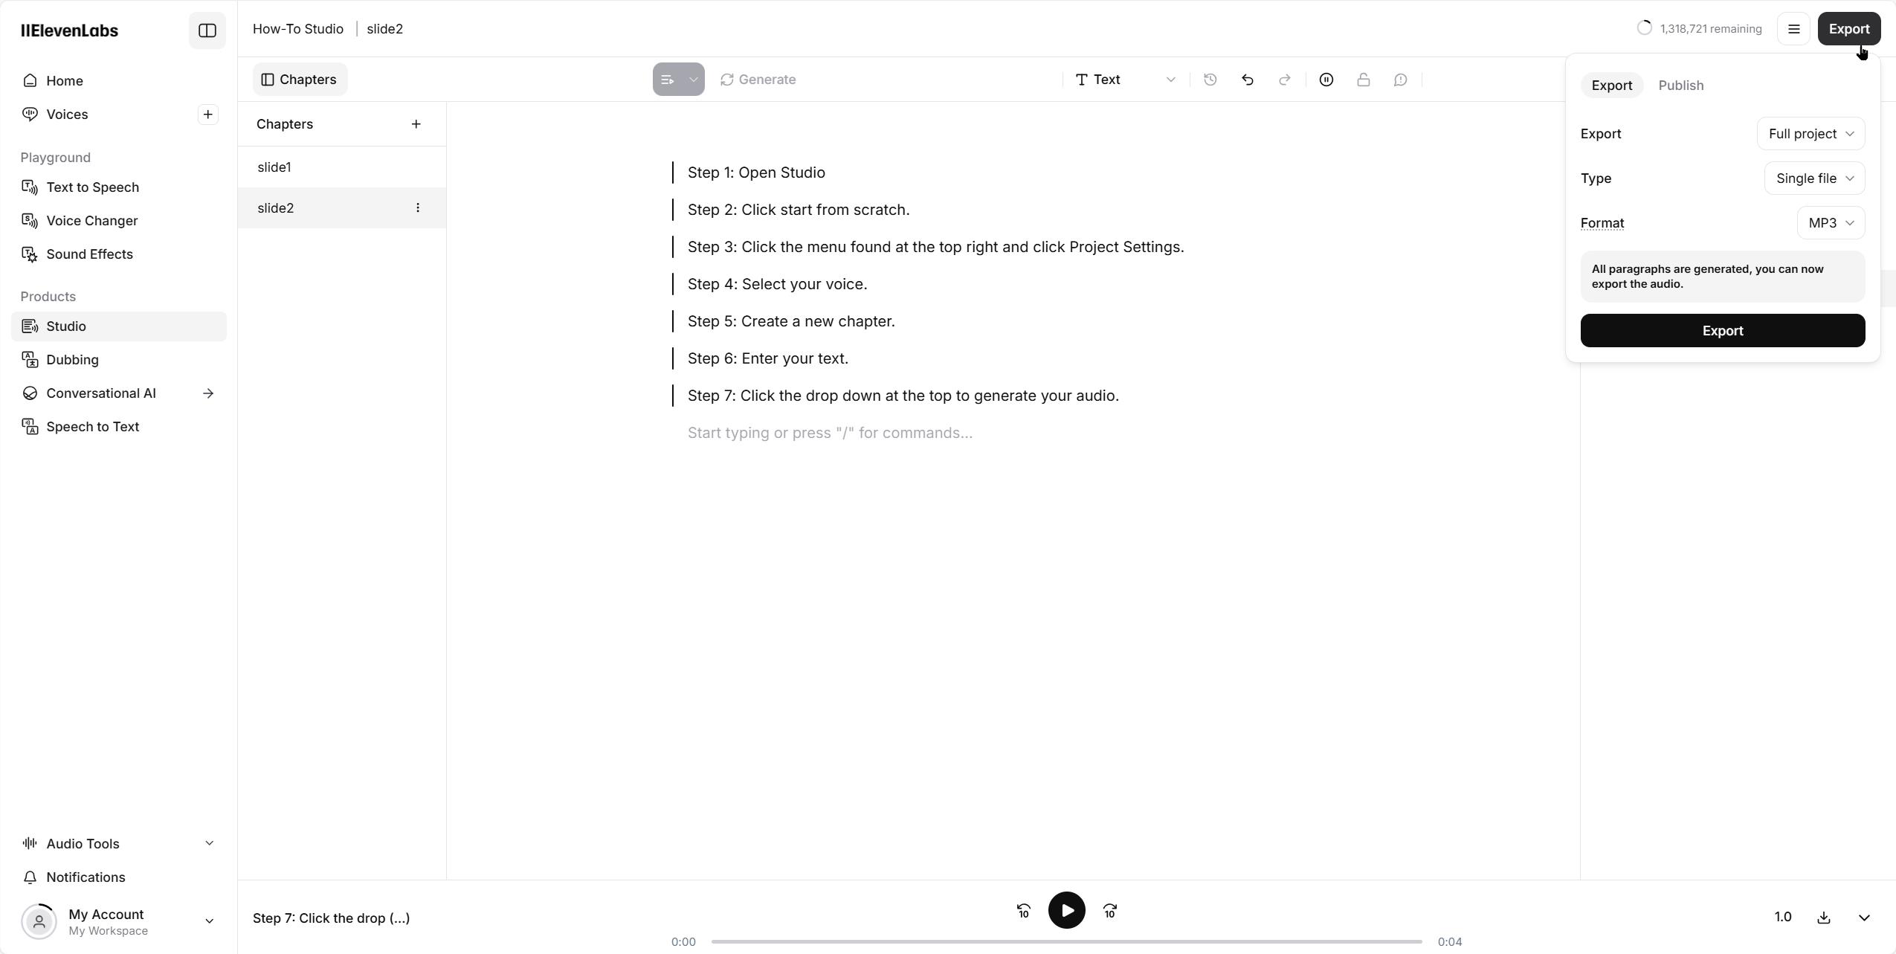
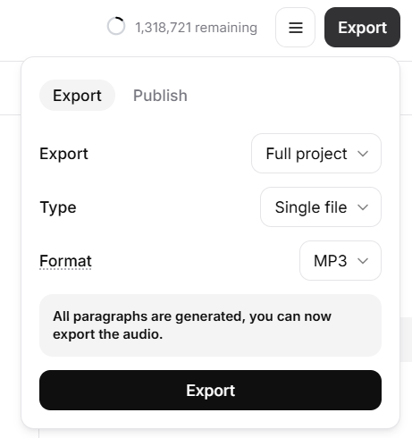
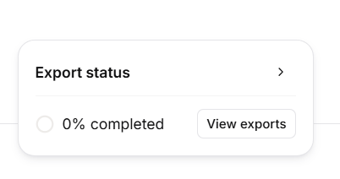
You can select full project or single chapter
You can select single file or zip. For full projects, we use .zip
Select .wav for export.
Click Export will process your audio. If the download doesn’t start, you can click download.

Slide 13
Troubleshooting

Slide 14
Troubleshooting
If the voice isn’t behaving the way you like, some things you can try.
Add a _ to the beginning of the word. Helpful for read, live, or any word that has multiple pronunciations
Group words together with “double quotes” when you want the correct emphasis
Spell words phoenetically. JSON = jsawn for example.
Add a space dash space ( - ) to add a natural pause.
Sometimes when you click + to add a slide there is a long delay. This is normal.
Sometimes you process, there is a long delay. This is normal.
You can double click the chapter name to rename it.
If the UI becomes unresponsive, refresh the screen (F5 PC, CMD-R for mac).
If the quality isn’t correct, click on the passage that has poor quality and click Generate/Regenerate at the top.

